Slide 1
LAHP AHRC Collaborative Doctoral Awards
(PhD start date: October 2024)​
​
https://www.lahp.ac.uk/prospective-students/collaborative-doctoral-awards-cda-scheme-proposals-by-academics/

Slide 2
Today’s session:
1 – 1:30pm Presentation from the LAHP team on Collaborative Doctoral Awards and the process for submitting a project proposal
1:30-2pm Q&A

Slide 3
The Q&A panel
Dr Marquard Smith | LAHP Deputy Director (Collaborations & Partnerships)
Gillian Harrison | LAHP Senior Support Officer
Nike Jonah | LAHP CDA student (Royal Central School of Speech and Drama in collaboration with Pan African Creative Exchange) and LAHP Student Ambassador
Dr Serena Iervolino | Lecturer in Critical Museology & Deputy Impact Lead (King's College London) and Lead Academic Supervisor for the 2023 LAHP CDA ‘The working-class museum: exploring the lived experiences of 21st century working-class Londoners’ - King’s College London in collaboration with Museum of London
Dr Domenico Sergi | Senior Curator (Museum of London) and working with Serena Iervolino as Partner Supervisor for the above project
Dr Elaine Leong; | Lecturer in History (UCL) and Lead Academic Supervisor for the 2023/24 LAHP CDA ‘Commonplacing Health and the Body in Early Modern England’ – University College London in collaboration with Wellcome Collection
Professor Angus Gowland | Professor of Intellectual History (UCL) and Second Academic Supervisor for the above project
Julia Nurse | Collections Research Specialist (Wellcome Collection) and Partner Supervisor for the above project

Slide 4
Questions for the Q&A:
Feel free to post in the chat or use the raise hand feature!

Slide 5
What is a Collaborative Doctoral Award (CDA)?
a CDA is a PhD developed and supervised in collaboration between an academic supervisor and an external, non-academic partner organization;
LAHP ring-fences 10% of its 90 studentships for CDAs each year (c.9 CDAs);
CDAs are funded for 3.5 years’ full-time study (or 7 years’ part-time), with the possibility of a further 6 months’ funding in cases where students are on a placement or need an extended period of training. The final submission deadline is not extended.

Slide 6
LAHP CDA priority areas
LAHP welcomes applications for projects across all subjects and approaches in the arts & humanities and with a wide range of collaborative partners. LAHP particularly encourages applications in four priority areas:
The exploration of under-represented collections, histories, knowledge, traditions or practices across the arts & humanities;
Transformative methods of engagement and/or practice to address inequity, marginalisation and/or barriers to inclusion in the arts, culture and heritage sectors;
Collaborative arts & humanities research with a wide range of organizations (including third sector, policy, voluntary, grassroots and/or activist) on under-representation, diversity and inclusion.
Arts & humanities focused research on sustainability, environment and climate crisis

Slide 7
LAHP CDA partners to date include:

Slide 9
Applying for a CDA (project proposal stage)
The project should be developed in collaboration with the prospective external partner;
The prospective lead academic supervisor completes and submits the application form via the online portal – full details here: https://www.lahp.ac.uk/prospective-students/collaborative-doctoral-awards-cda-scheme-proposals-by-academics/;
The application can include a nominated student, but does not need to do so;
The deadline for applications is 13:00 on 13 October 2023;
If a successful application does NOT include a nominated student, the CDA will be advertised, and the supervisor will organize interviews.

Slide 10
Eligibility for academic supervisors
The lead academic supervisor who submits the proposal, must be based at one of the eight LAHP HEI’s
Lead academic supervisors can submit a maximum of two separate applications
Previously unsuccessful CDA projects can be re-submitted in the following year. The panel will assess the same project (i.e., same academic and partner institution) for a maximum of two years in a row.

Slide 11
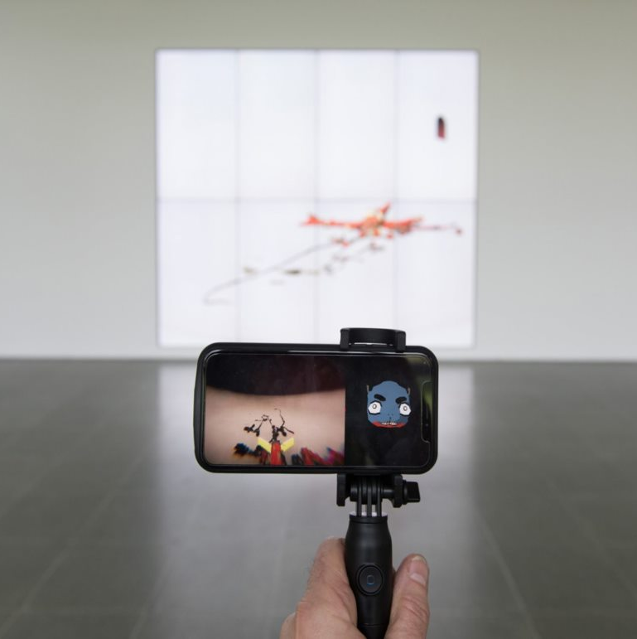
If you are a prospective student with an idea for a CDA, please contact a potential academic supervisor in one of LAHP’s eight partner HEIs, or email cda.lahp@london.ac.uk for assistance in identifying a potential supervisor.
If you are from an organization outside academia and have an idea for a CDA, please contact a potential academic supervisor in one of LAHP’s eight partner HEIs, or email cda.lahp@london.ac.uk for assistance in identifying a potential supervisor.
All CDA applications must be submitted by the lead academic supervisor, with support from a collaborative partner.
Photo credit: Ian Cheng Serpentine Gallery installation view BOB ©2018 Hugo Glendinning. Courtesy of the artist and Serpentine Galleries.

Slide 12
LAHP CDA assessment criteria
Quality and originality of the proposed research | 30%
Quality of the proposed collaboration | 30%
Clearly defined potential for cultural, societal and/or economic impact in collaboration with the partner organization | 20%
Feasibility of the research | 20%
AHRC assessment scale from 6 (highest priority for funding) to 1 (unfundable).
The full assessment criteria can be found here: https://www.lahp.ac.uk/wp-content/uploads/2023/07/LAHP-Collaborative-Doctoral-Award-Assessment-Criteria-for-Project-Proposals_24-25.pdf

Slide 13
Eligibility for students
LAHP welcomes applications from students with ‘home’ and ‘international’ (including EU) status (Please refer to ‘International Students‘);
Students must meet the required qualifications to be eligible for their chosen doctoral programme (e.g., a Masters degree) and those with relevant professional and/or practitioner experience;
Applications are accepted from students wishing to study on either a full-time or part-time basis;
LAHP welcomes applications from students of all ages and backgrounds;
If a student has already commenced doctoral study, they cannot apply to transfer to a Collaborative Doctoral Award.

Slide 14
CDA timeline
June 2023 | Applications for project proposals open via the LAHP website: https://www.lahp.ac.uk/prospective-students/collaborative-doctoral-awards/
13 October 2023, 1pm | Project proposal application deadline (late applications will not be accepted).
w/c 13 November 2023 | CDA Panel meets to assess applications for project proposals, outcomes communicated to supervisors.
w/c 4 December 2023 | Open for CDA candidates’ applications (for CDA projects without nominated candidates).
26 January 2024, 5pm | CDA Applications’ deadline to LAHP. Applicants must apply for a place to study within the institution of the first academic supervisor before they apply to LAHP.
January – April 2024 | Recruitment of students to projects without a nominated candidate.
Early May 2024 | LAHP Studentship Award Panel confirms recruited students as recipients of a CDA
Early May 2024 | Outcome communicated to supervisors. Award letter sent to students
1 October 2024 | Student commences doctoral study

Slide 15
All details, including the application form, assessment criteria, and examples of previous successful proposals available here:
https://www.lahp.ac.uk/prospective-students/collaborative-doctoral-awards/
Our email:
cda.lahp@london.ac.uk
Deadline for project proposal submissions: 1pm Friday 13th October 2023
The next information session will take place when student applications open in early December 2023

