Slide 1
LAHP AHRC Collaborative Doctoral Awards
(PhD start date: October 2024)​
​
https://www.lahp.ac.uk/prospective-students/collaborative-doctoral-awards-projects-available/

Slide 2
Today’s session:
1 – 1:30pm Presentation from the LAHP team on Collaborative Doctoral Awards and the process for submitting an application
1:30-2pm Q&A
Q&A panel: Dr Marquard Smith, LAHP Deputy Director for Collaborations and Partnerships; Gillian Harrison, LAHP Senior Support Officer; Nike Jonah, LAHP CDA student and Student Ambassador

Slide 3
Questions for the Q&A:
Feel free to post in the chat throughout the presentation or use the raise hand feature!

Slide 4
What is LAHP?
LAHP is a Doctoral Training Partnership co-funded by the Arts & Humanities Research Council (AHRC) and its eight HEI partners.
LAHP funds up to 90 PhD studentships in subjects across the Arts & Humanities;
Of these 10% are Collaborative Doctoral Awards involving a cultural or other external partner;
Up to 30% of LAHP’s studentships can be awarded to international students;
Black and Global Majority Awards and dedicated awards for students from underrepresented groups.

Slide 5

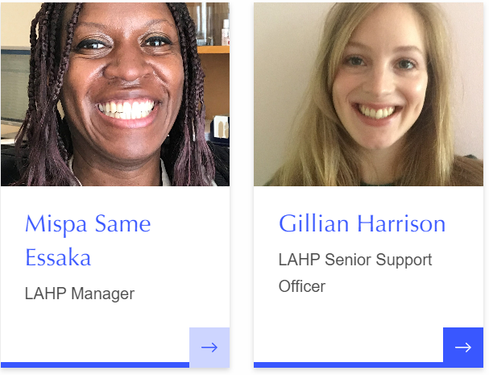
LAHP team:

Slide 6




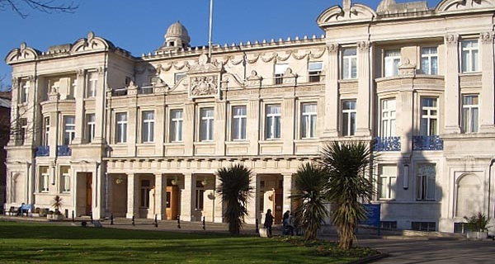




Slide 7
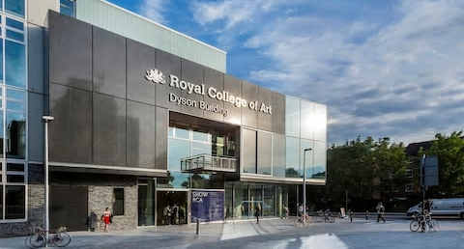
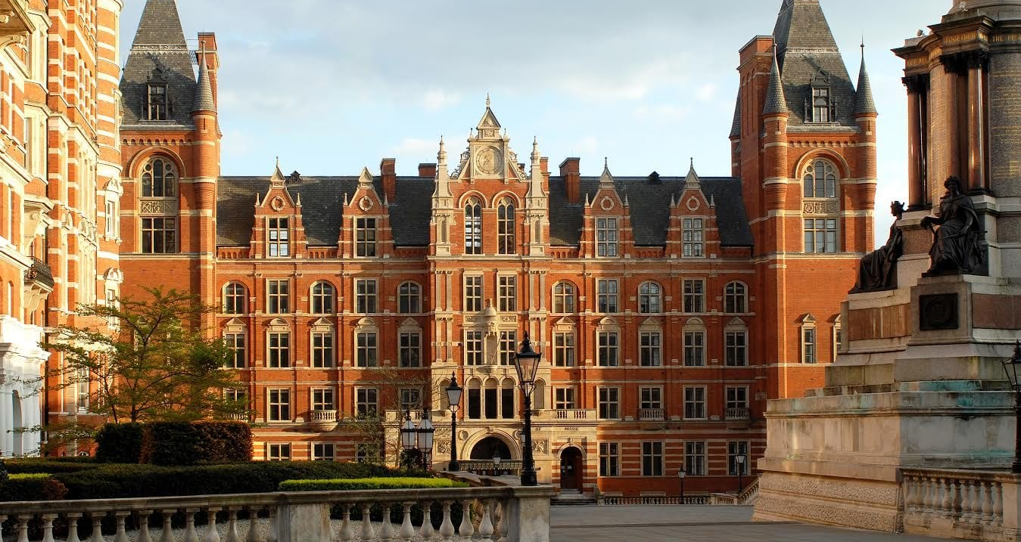







Slide 8







Slide 9
What is a Collaborative Doctoral Award (CDA)?
a CDA is a PhD developed and supervised in collaboration between an academic supervisor and an external, non-academic partner organization;
LAHP ring-fences 10% of its 90 studentships for CDAs each year (c.9 CDAs);
CDAs are funded for 3.5 years’ full-time study (or 7 years’ part-time), with the possibility of a further 6 months’ funding in cases where students are on a placement or need an extended period of training. The final submission deadline is not extended.

Slide 10
What is a Collaborative Doctoral Award (CDA) continued?
- (CDAs) provide funding for doctoral students to work on a project in collaboration with an organisation outside higher education
- They encourage and develop collaboration and partnerships and provide opportunities for doctoral students to gain first-hand experience of work outside the university environment
- They enhance the employment-related skills and training available to the research student during the course of the award
- The studentship includes a stipend at the Research Council UK Home/ EU rate (£20,622 per annum – 2023/24 rate) plus fees for 3.5 years (calculated pro rata if studying part-time). The awarded candidate will also be entitled to a £600 per annum stipend top-up.

Slide 11
LAHP welcomes applications from:
UK and international students who meet the residency requirements as detailed on the UKRI Guidance document on EU and International eligibility
Please note that the AHRC will only fund the Home fee for international applicants. The funding to cover the difference between the Home and international fee must be sought elsewhere (i.e. from an institutional, external funder or student contributions).
LAHP encourages all international applicants to apply to other funding sources that could cover the difference between the Home and international fee.

Slide 12
Eligibility for students
Students must meet the required qualifications to be eligible for their chosen doctoral programme (e.g., a Masters degree) and those with relevant professional and/or practitioner experience;
Applications are accepted from students wishing to study on either a full-time or part-time basis;
LAHP welcomes applications from students of all ages and backgrounds;
If a student has already commenced doctoral study, they cannot apply to transfer to a Collaborative Doctoral Award. However, they can apply for the LAHP Open Studentship Competition.

Slide 13
LAHP CDA projects available in 2024/25:
https://www.lahp.ac.uk/prospective-students/collaborative-doctoral-awards-projects-available/

Slide 14
How to apply
All candidates must submit their application for a PhD place to the relevant HEI prior to submitting their CDA application to LAHP
Apply for your place of study well in advance of the LAHP application deadline, and check individual institutions’ deadlines
Then submit your LAHP CDA Studentship Application 2024-25 via the online portal https://lahp.flexigrant.com/startapplication.aspx?id=12709

Slide 15
Application
As part of your LAHP application, you will be required to submit the following:
a LAHP Diversity Monitoring Form
a copy of your CV
copies of Transcripts for all relevant degrees
2 academic References, or 1 academic and 1 professional reference (through the online portal you will be able to send reference requests to your referees’ email addresses.
It is your responsibility to ensure that both references are submitted on time for you to complete your application submission by the deadline below.
The full application will need to be submitted by 5pm on Friday 26th January 2024.

Slide 16
Timeline
26th January 2024 at 5pm: LAHP CDA application deadline (including 2 references).
CDA applicants must apply for a place to study within the institution of the first academic supervisor prior to submitting their CDA application to LAHP.
March – May 2024
Mid-March: Selected students are invited to interview with the relevant CDA project team
w/c 18th & 25th March: Interview period
By end of April 2024 – Students must be in receipt of an offer on their chosen PhD programme at a LAHP partner institution (LAHP conducts these checks directly with the HEI Admissions Offices)
Early May: LAHP Studentship Award Panel approves nominated students as recipients of a LAHP CDA studentship
May: Outcome of students to be awarded a CDA studentship conveyed to supervisors.
1st October 2024: Student commences CDA PhD study

Slide 17
Details of the application process, including full information on the projects available for 2024-25 can be found here:
https://www.lahp.ac.uk/prospective-students/collaborative-doctoral-awards-projects-available/
Our email:
cda.lahp@london.ac.uk
Deadline for LAHP applications: 5pm Friday 26th January 2024

