Slide 1
LAHP Open Studentship Competition
(PhD start date: October 2024)
Professor Johanna Malt, LAHP Director
Professor Tony Fisher, LAHP Deputy Director (Training and Cohort Development)

Slide 2
What is LAHP?
LAHP is a Doctoral Training Partnership co-funded by the Arts & Humanities Research Council (AHRC) and its eight HEI partners.
LAHP funds up to 90 PhD studentships in subjects across the Arts & Humanities;
Of these 10% are Collaborative Doctoral Awards involving a cultural or other external partner;
Up to 30% of LAHP’s studentships can be awarded to international students;
Black and Global Majority Awards and dedicated awards for students from underrepresented groups.

Slide 3
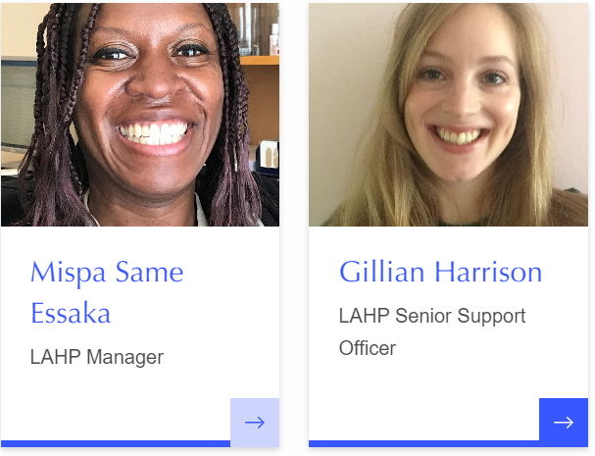

Slide 4
LAHP Team
Prof. Johanna Malt | Director
Prof. Tony Fisher | Deputy Director (Training & Cohort Development)
Dr Marquard Smith | Deputy Director (Collaborations & Partnerships)
Mispa Same-Essaka | Manager
Gillian Harrison | Senior Support Officer
www.lahp.ac.uk info.lahp@london.ac.uk

Slide 5
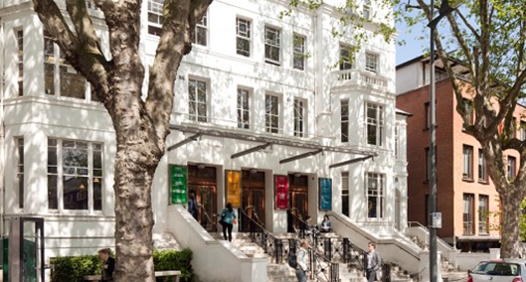

Slide 6
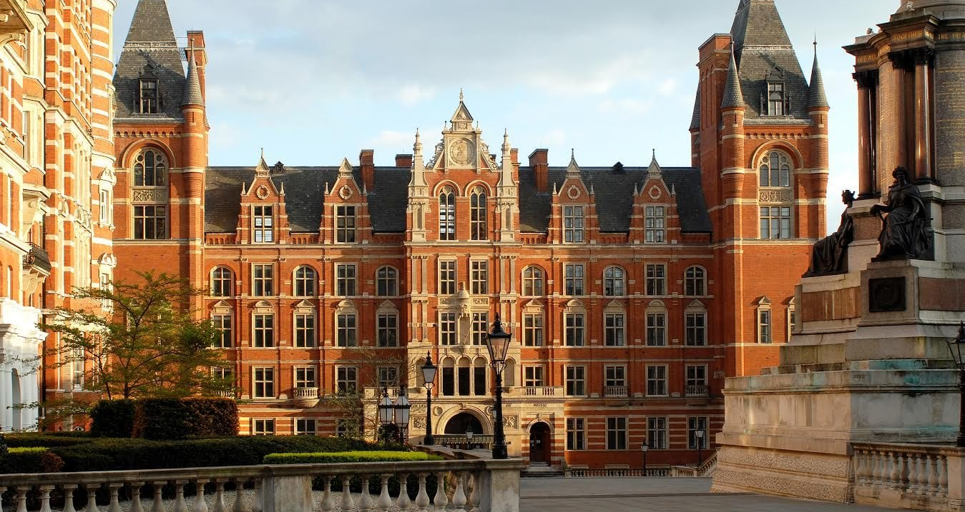

Slide 8
LAHP welcomes applications:
across all of LAHP’s subject areas and approaches in the arts and humanities, including for inter-disciplinary and practice-based research;
from those who have recently completed their Master's programmes and those with relevant professional and/or practitioner experience;
from those wishing to study on a full- or part-time basis;
from applicants of all ages and backgrounds.

Slide 9
International applicants
LAHP can award up to 30% of its studentships (including stipend) to international applicants (including EU students).
The AHRC will fund only the Home fee. The difference between the Home and International fee must be found elsewhere. Students should discuss with their prospective supervisors whether the HEI they are applying to could potentially cover this fee difference. If an HEI is able to cover the fee difference, this will be confirmed in the award letter from LAHP.
LAHP encourages all international applicants to apply to additional funding sources where available to cover the difference between the Home and International fee as there is no guarantee that their HEI will cover this fee difference.
Please note: your fee status will be determined by the university you're applying to, not by LAHP.

Slide 10
Ring-fenced Awards: Black and Global Majority, Gypsy/Traveller/Roma applicants
Structural inequalities in education have resulted in the under-representation of Black and Global Majority doctoral students, and those of Gypsy, Traveller or Roma heritage. LAHP is committed to increasing the number of awards made to doctoral students from these groups.
A minimum of five studentships will be awarded to Home fee status Black and Global Majority applicants. We aim to award a minimum of three of these studentships to Black British applicants.
A minimum of one studentship will be awarded to Home fee status applicants of Gypsy, Traveller or Roma heritage.
All students should apply to LAHP’s Open Studentship Competition in the normal way. There will be a tickbox to indicate your eligibility.
https://www.lahp.ac.uk/prospective-students/how-to-apply-for-an-open-studentship/

Slide 11
Studentships
Funding is for 3 years (3.5 years for CDAs) full-time study (or part-time equivalent), with the possibility of a further 6 months’ funding for a placement or extended training;
The final submission deadline remains the same;
Students who have already completed one year full-time, or up to three years part-time, PhD study are eligible to apply. Funding will cover the remaining period of their study (i.e. two years full-time, 3-5 years part-time).

Slide 12
Our Commitment to Equality, Diversity and Inclusion
LAHP has a strong commitment to promoting and supporting equality, diversity and inclusion.
We are committed to the provision of equality of opportunity for all of our applicants, students and staff.
We are committed to a community in which all people can learn, work and interact freely without fear of discrimination, prejudice or harassment.
All applicants, students, staff, supervisors and stakeholders will be treated equitably and will not be accorded less favourable treatment on the grounds of: gender, marital/civil partnership status, sexual orientation, gender re-assignment, race, colour, nationality, ethnicity or national origins, religion or similar philosophical belief, spent criminal conviction, age or disability.

Slide 13
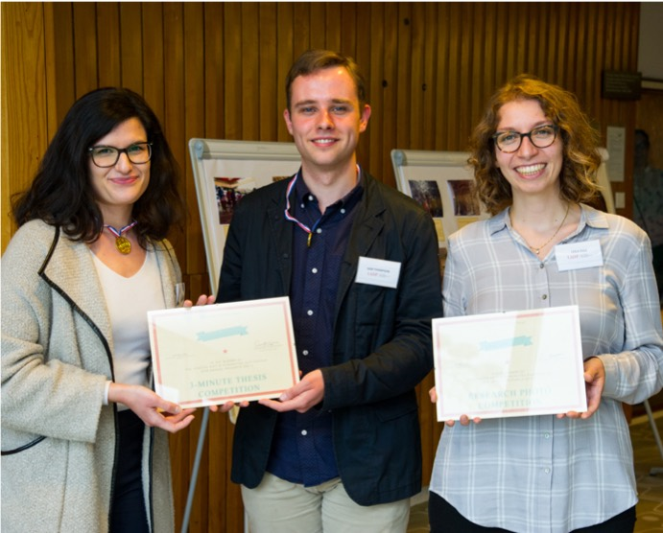
Training
LAHP also supports funded students through its training programme which includes:
Language courses
Research skills and methodologies
EDI and resilience training
Professional skills, networking and careers
Public engagement and impact
Digital arts and humanities

Slide 14
Placements
LAHP students have the opportunity to go on placements with cultural or other partners which are great opportunities to gain experience in the wider world in areas not directly related to their research project.
Other funding opportunities
For extensions; research and training; impact, engagement and entrepreneurship; student-led activities.
Stephen Hills: placement at the Derek Jarman Lab.

Slide 15
Cohort Development
LAHP recognizes the importance of PhD students feeling part of a wider community.
We have a number of events throughout the year to which all LAHP students, and wherever possible their supervisors, are invited.
These are opportunities to get to meet fellow PhD students across the partnership and learn about each others’ research.
Student-led networks include: Black & Global Majority Network, Women Researchers' Network, Practice-based Research Network.

Slide 16
Studentship Competition Timeline, 2023/24
Now Application template and guidance available at www.lahp.ac.uk
27 November 2023 Applications open via the LAHP online portal
26 January 2024 5pm application deadline. Applications received after this deadline will not be considered. Students must already have applied for a PhD place at a LAHP partner HEI. Applications must include the supervisor statement.
Mid-March 2024 Students must be in receipt of an offer for their chosen PhD programme
28 April 2024 LAHP offers to successful candidates
Within two weeks of the offer of award – students to accept/decline the offer
1st October 2024 Studentships to begin

Slide 17
What We Are Looking For
Applications will be judged against clear criteria. Scoring will be based on:
Quality of the Research Proposal (worth 50%)
Preparedness of the Student (worth 25%)
Feasibility of Proposed Research (worth 25%)

Slide 18
What We Are Looking For
Quality of the Research Proposal (worth 50%)
Significance, originality and clarity of research proposal;
Underpinning ideas, aims and research questions;
Research design, methodology and/or sources;
Suitability of proposal for doctoral research;
Dissemination and potential impact.
Demonstrated by
Research proposal; Non-technical summary; Key references;
Supervisor statement

Slide 19
What We Are Looking For
Preparedness of the Student (worth 25%)
Previous academic achievements in relevant subject areas and/or:
Relevant professional / practitioner experience (particularly for applicants with non-standard academic trajectories);
Relevant knowledge, skills and/or training for proposed research.
Demonstrated by
Academic qualifications (awarded and pending); Professional / practitioner experience; Personal statement; Supervisor statement

Slide 20
What We Are Looking For
Feasibility of the Proposed Research (worth 25%)
Likely completion within the timeframe;
Identification of training needs;
Justification of fieldwork and study visits;
Synergy with proposed supervisors’ research and wider intellectual culture of the department, HEI and LAHP.
Demonstrated by
Timetable; Additional training needs; Research proposal; Personal statement; Supervisor statement.
Photo credit: Ian Cheng Serpentine Gallery installation view BOB ©2018 Hugo Glendinning. Courtesy of the artist and Serpentine Galleries.

Slide 21
Before You Apply to LAHP
Make sure that you are eligible for AHRC funding (subject area; length of time completed if you are a continuing student)
Make sure that you have applied for a PhD place at one of the LAHP HEI partners
Make sure that you have discussed your proposal and your LAHP application with your proposed primary supervisor
Make sure that you and the department you are applying to have identified TWO supervisors (whether first and second supervisors or joint supervisors). NB LAHP requires the names of both supervisors. LAHP supervisors can be at the same or different HEIs.

Slide 22
Personal Statement (600 words)
What knowledge, skills and training would you bring to the proposed research?
How and why is the proposed research suitable for a LAHP studentship?
How would you seek to benefit from, and contribute to, LAHP?
How might you want to engage with different audiences and organizations during your research?
Supervisor Statement
About both supervisors: relevant research experience, supervisory experience and total number of current students (up to 200 words per supervisor)
Quality of the proposed research (up to 300 words)
Preparedness of the applicant (up to 150 words)
Feasibility of the proposed research (up to 150 words)

Slide 23
How to Apply
The online portal for applications will open on 27 November 2023: https://lahp.flexigrant.com/
Key information required:
Research Proposal
1200 words on significance and originality; underpinning ideas, aims and research questions; research design, methodology and/or sources (including practice-led research).
Up to 10 key references cited in the proposal.

Slide 24
Subject Area Group | Disciplinary Cluster
Archaeology | A1 Histories, Cultures & Heritage | Studentship Award Panel
Art History
Classics
Cultural & Museum Studies, including cultural geography & area studies
History (medieval and early modern)
History (modern pre-1945)
History (modern post-1945)
Development Studies & Political Science & International Studies | A2 Thought, Values and Information
Ethnography & Anthropology
Law & Legal Studies
Philosophy (Theoretical)
Philosophy (Practical)
Theology, Divinity & Religion
Design | B Creative & Performing Arts
Drama & Theatre
Film Studies
Information, Media and Communications
Music
Visual Arts
English (pre-1900) | C Languages & Literature
English (post-1900)
Creative writing
Linguistics
Modern Languages
Comparative Literature

Slide 25
Final Advice
Competition is very strong (545 applications in 2023 for 81 places in the Open Competition)
Start thinking about your project as soon as possible;
Look at the LAHP website to find out more about current PhD research projects;
Find a potential supervisor as soon as you have a project in mind (following the process appropriate to your HEI);
Take your time in writing your research proposal and personal statement;
Read the online guidance when you are completing the application form.

Slide 26
Thank you & good luck!
https://www.lahp.ac.uk/prospective-students/how-to-apply-for-an-open-studentship/

Slide 27
Any Questions?

